Slide 1
Course Name
Newton’s laws of motion

Slide 2
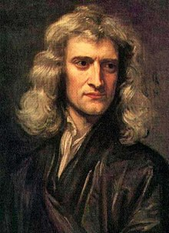
Sir Isaac Newton (1642 – 1727) was an English mathematician, astronomer, theologian, author and physicist.
He is regarded as one of the most influential scientists of all time, and a key figure in the scientific revolution.
Newton formulated the laws of motion and universal gravitation, which has dominated scientists' view of the physical universe. He worked out the “three laws of motion” governing the movement of all objects at all times an in all circumstances.

Slide 3
Newton’s 1st Law: An object at rest will stay at rest, and an object in motion will stay in motion at constant velocity, unless acted upon by an unbalanced force.
Newton’s 2nd Law: Force equals mass times acceleration.
Newton’s 3rd Law: For every action there is an equal and opposite reaction.

Slide 4
2nd Law of Motion:
The net force (F) of an object is equal to the product of its mass (m) and acceleration (a), or F=ma.
“sigma” = sum
of all forces, or
net force.
F and a
are vectors,
mass a scalar

Slide 5
2nd Law of Motion:
When mass is in kilograms (kg) and acceleration is in m/s/s (or m/s²), the unit of force is in newtons (N).
1 N = force required to accelerate 1 kg of mass at 1 meter/second/second.
Example: How much force is needed to accelerate a 1400 kilogram car 2 meters per second/per second?
Apply the formula (F = ma)
Fill in given numbers and units (F = 1400 kg x 2 meters per second/second)
Calculate the solution (2800 kg-meters/second/second or 2800 N)

Slide 6
2nd Law of Motion:
This Law proves that different masses accelerate to the earth at the same rate, even though they may have different forces.
Objects with different masses accelerate to the ground at the same rate. Due to the 2nd Law however, they do not hit the ground with the same force (see the next slide).

Slide 7
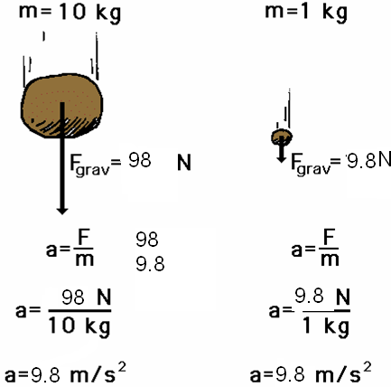
2nd Law of Motion:
F = ma
98 N = 10 kg x 9.8 m/s/s
F = ma
9.8 N = 1 kg x 9.8 m/s/s

Slide 8
2nd Law of Motion:
Forces are not directly observable, but the effect of force is perceived. Newton’s Second Law defines force as the effect of mass accelerating.
Net force (also called resultant) causes an object to accelerate.

Slide 9
References:
https://www.slideshare.net/wilsone/newtons-laws-of-motion-1949387
https://www.slideshare.net/pvnkmrksk/newtons-laws-of-motion-2587754
https://www.grc.nasa.gov/www/k-12/airplane/newton.html
http://www.physics4kids.com/files/motion_laws.html
https://phet.colorado.edu/en/simulation/forces-and-motion-basics
https://www.youtube.com/watch?time_continue=370&v=KvPF0cQUW7s
https://www.youtube.com/watch?v=NYVMlmL0BPQ
https://www.youtube.com/watch?v=3jVHQ8bECIs
https://www.youtube.com/watch?v=Ixf9ZyZaE9Q

